Slide 1
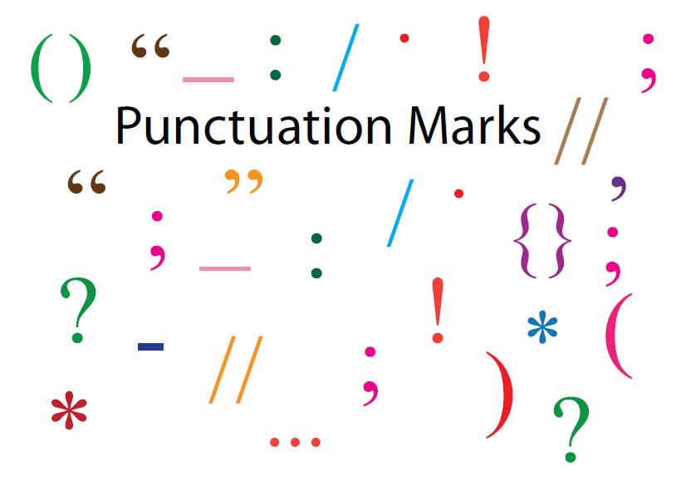

Slide 2
Punctuation is the system of symbols that we use to separate sentences and parts of sentences, and to make their meaning clear. Each symbol is called a punctuation mark.
MARKS PRIMARILY TO END A SENTENCE (Full stop, Question Mark , Exclamation Mark)
MARKS PRIMARILY TO SEPARATE PARTS OF A SENTENCE (Semi-Colon, Colon, Comma, Dash, Parentheses)
OTHER PUNCTUATION MARKS (Brackets, Quotation Marks, Quotation Marks, Ellipses, Apostrophe, Hyphen)

Slide 3
MARKS PRIMARILY TO END A SENTENCE
Full stop (Period) [ . ]
Use a period to end a sentence (in most cases it coincides with the Russian punctuation. No examples are given).
Use a period for an abbreviation: Mr., Mrs., Dr. If the letters of an abbreviation form a word (an acronym), omit the periods: UNICEF, NATO.
With some common abbreviations that don’t form a word, you have the option of omitting periods: 3 pm or 3 p.m. Whatever form you choose, be consistent.
Use a period (point) in decimal fractions: 5.6 or 9.96.

Slide 4
Question Mark [ ? ]
Use a question at the end of a direct question. (Do not use it for an indirect one.)
Sometimes a question mark is used in addressing a person: Betty? Are you going with us?
In a polite request, when you do not expect a verbal answer, use a period instead of question mark: Will you please send me the form next week?

Slide 5
Exclamation Mark [ ! ]
Use an exclamation mark for an exclamatory statement. Try to avoid it in academic or business writing.

Slide 6
MARKS PRIMARILY TO SEPARATE PARTS OF A SENTENCE
Semi-Colon [ ; ]
Use a semi-colon between closely related independent clauses, especially before thus, however, therefore. Don’t overdo with it.
Preparing the lunch took 4 hours; eating it took ten minutes.
I realize I need exercise; however, I’ll ﬁrst think about it.
Use a semi-colon between items in a series if there are already commas within each of them:
(–) The honored employees were Helen Smith, the controller, Jean Hardy, her assistant, and Dr. Jack Hansford.
(+) The honored employees were Helen Smith, the controller; Jean Hardy, her assistant; and Dr. Jack Hansford.
(The semi-colons in the second sentence get rid of confusion about the number of employees.)

Slide 7
Colon [ : ] A colon is a sign that something is to follow
Use a colon after an independent clause, to introduce an explanation:
This is his advice: hire an accountant.
Use a colon before a list, especially if the list is arranged vertically:
We transferred three employees to new branches: Mary Aster to Victoria; John Foster to Calgary; Max Cohen to Toronto.
If the list runs horizontally, use a colon only if the part preceding it is a complete sentence:
(–) We want: three chairs, two desks, a bookcase.
(+) We want three chairs, two desks, and a bookcase.
or
(+) We want the following furniture: three chairs, two desks, and a bookcase.

Slide 8
Colon [ : ]
Use a colon before a formal quotation (just like in Russian).
Use a colon after a salutation in a formal business letter:
Dear Professor Hummel:
Use a colon between numerals when giving the time:
3:20 a.m. or 16:00
Use a colon between a title and subtitle:
Managing Change: A Guide for the Nineties.

Slide 9
Comma [ , ]
Use a comma between items in a simple series:
Give me some pens, paper, and an aspirin.
Although a comma before the ﬁnal conjunction (‘or’, ‘and’) is optional, it will often avoid confusion:
(–) The company suffered from old machines, inefﬁcient manufacturing processes and increased competition.
(+) The company suffered from old machines, inefﬁcient manufacturing processes, and increased competition.
Use a comma between adjectives that precede and modify the same noun: her interesting, diverse responsibilities
but: favorite little restaurant (here favorite modiﬁes not restaurant, but little restaurant; therefore, no comma is needed. A simple test is to see if you can reverse the adjectives. If you can, use a comma.)

Slide 10
Comma [ , ]
Use a comma before a coordinating conjunction (and, or, but, nor, yet) connecting two independent clauses (just like in Russian):
The pizzas arrived, and we ate them immediately.
Note: However, therefore, and thus are not coordinating conjunctions, since they can go in various places other than between two independent clauses:
(–) I felt like shouting, however I managed to stay calm.
(+) I felt like shouting; however, I managed to stay calm.
(+) I felt like shouting; I managed to stay calm, however.

Slide 11
Comma [ , ]
Use a comma to separate an independent clause from a preceding one:
When he had arrived, we toured the plant.
Since it’s late, let’s have dinner.
(When the dependent clause follows the independent one, a comma is often omitted: We found the lost ticket after the train had left.)
Use a comma after a long introductory phrase:
In the middle of the coldest winter on record, the pipes froze.
Use a comma to set off a naming phrase:
My boss, Enid Miller, is on holiday.
or
Mr. Hunter, our Vice-President, will make the decision.

Slide 12
Comma [ , ]
Use a comma on both sides of an interruptive phrase:
We suspect, as you have guessed, that the letter is lost.
Mr. Jones, who comes from Halifax, will join the ﬁrm in June.
NB! If a relative clause is essential to the meaning of the noun phrase it modiﬁes, DO NOT use commas to set it off, or it will cause serious muddles, as suggested by these two sentences:
All part-time employees, who aren’t in the regular beneﬁts plan, should obtain this insurance.
All part-time employees who aren’t in the regular beneﬁts plan should obtain this insurance.
In the ﬁrst sentence, all part-time employees are directed to buy insurance. In the second sentence, only those who aren’t in the regular beneﬁts plan are told to get it.

Slide 13
Comma [ , ]
Use a comma before a short, direct quotation:
He said, ‘Let’s take a break’.
Do not use it before an indirect quotation:
He said we should take a break.
Use a comma before a tag [disjunctive] question:
She is a good organizer, isn’t she?
Use a comma before parts of
— an address (1910 Hill Street, Ann Arbor, Michigan);
— a date when the name of the day precedes it (Monday, May 3);
— large quantities (3,000,000).

Slide 14
Dash [ — ]
Use a dash to emphasize the phrase that follows or an interrupting phrase:
We got their approval — at last.
The cheque was late — as usual — but at least it didn’t bounce.

Slide 15
Parentheses [ ( ) ]
These are always drawn as curved enclosures, to be distinguished from brackets, which are square:
In his speech, Fraser predicted increased activity (Empire Club, May 10, 1985).
Despite the gloomy economic forecast (see Figure 2), sales revenues are up 10% from the forecast.
Or:
(1) xxx
(2) xxx
(3) xxx (to enclose numbers when listing material)

Slide 16
OTHER PUNCTUATION MARKS
Brackets [ [ ] ]
Use brackets to mark any additions you make to a quotation:
Jones said, ‘The costs of indexed pensions are more than they [taxpayers] realize.
Use brackets around the word sic (sic erat scriptum), to show that any misspelling or misuse of the preceding word or phrase is in the original quotation:
Their sign said, ‘Ban all the missies [sic]. Ban the bomb.’

Slide 17
Quotation Marks [ “ ” ] or inverted commas [‘ ’]
Use quotation marks in quotations or to emphasize the word
Italics [ Italics ]
Italics are cursive letters, as opposed to ordinary letters. They are used to emphasize the idea or a word, for foreign words, or titles of books.
The word parameters has become a part of business jargon.
Ellipses [ ... ]
Use ellipses (three periods) to show that part of a quotation is missing, or that a series of numbers continues indeﬁnitely:
He maintained that ‘Kelso is a proﬁtable business ... with a great future.’
2, 4, 6, 8 ...

Slide 18
Apostrophe [ ’ ]
Use the apostrophe in the possessive case (Mark’s pen, Chaikovsky’s music) and to show contraction of words or numbers (isn’t, I’m, summer vacation’2011, Olympics’2012).
If the word ends in s, you have the option of simply adding an apostrophe: Dickens’ life, Mary Poppins’ umbrella, Belarus’ capital (but Belarus’s economy is also correct).
Caution: Don’t confuse it’s — a short form of it is or it has — with its, which never has an apostrophe.

Slide 19
Hyphen [ - ]
Use a hyphen to separate compound words:
father-in-law, passer-by, governor-general.
Use a hyphen to separate compound numbers:
twenty-one.
Use a hyphen after preﬁxes self, all, ex, anti, and any preﬁx if it aids clarity:
ex-President, self-sufﬁcient, pro-government.
Use a hyphen between compound modiﬁers:
a two-day seminar, a second-year student, one-half full.

Slide 20
1. PUNCTUATE THE FOLLOWING SENTENCES:
1) on Friday June 10 at 9 30 a m the premier will meet the union leaders however he is not expected to make an announcement afterwards.
2) Jeffs article about Magnum Corporation A Study in Entrepreneurship is a good one but its not likely to be published.
3) When the Lewiss car lost its mufﬂer Sam had to take it to Susans fathers garage.
4) Thats a nineteenth century attitude Ann said but at least its not hypocritical.
5) People who are shy often have spouses who do most of the talking for them or so it seems.
6) The treasurers report see Appendix A gives details of our ﬁnances and unfortunately we still have a large debt to be paid off.

Slide 21
2. PUNCTUATE THE FOLLOWING SENTENCES:
1. The new regulations will prove to be to everyones disadvantage.
2. All of these books are to be catalogued the ones on geology natural history philosophy and scientiﬁc method.
3. As well as being an excellent basketball player the girl was also a member of the winning squash team.
4. The point is according to my understanding that we should move quickly.
5. Instead Chambers 1988 suggests the importance of the genetic inﬂuence in determining the antecedents.
6. It was found however that most of the liquid could not be absorbed.
7. The miner his face covered in mud climbed slowly out.
8. The trend toward specialization is very clear particularly in the professions see Table 2.
9. Once daylight came we thought we were safe however this was not to be.
10. Keats poem ‘To Autumn’ is possibly the greatest evocation of that season ever written.
11. After their long walk the boys noses were red with cold.
12. Its not easy to isolate its cause but we think its due to the torrential rain we had recently.
13. The car left the road rolled down the bank turned over several times hit a free and then burst into ﬂames.
14. Gourmets and arent we all gourmets will particularly enjoy the marinated quail.
15. It was a rather hit or miss affair we found to our horror that we were expected to provide the entertainment as well.

Slide 22

Of
Слепович В.С. Academic Writing and Speaking Course Pack: пособие по английскому академическому письму и говорению / О.И.Вашкевич, Г.К.Мась; под ред. В.С. Слеповича.– Минск :ТетраСистемс, 2012.

